Slide 1
Introduction to Python

Slide 2
What is Python?
Python is a programming language that lets you work more quickly and integrate your systems more effectively.
# This program prints Hello, world!
S = 'Hello, world!'
print(S)
#include <stdio.h>
int main()
{
// printf() displays the string
printf("Hello, World!");
return 0;
}
Python
public class HelloWorld {
public static void main(String[] args) {
// Prints "Hello, World" to the terminal window.
System.out.println("Hello, World");
}
}
curly-brackets
C
semicolons
Java
Notes:
For this class we use Python 2.7.

Slide 3
Why Python?
1. Easy to use:
works on different platforms (Windows, Mac, Linux, Raspberry Pi, etc).
runs on an interpreter system, meaning that prototyping can be very quick.
2. Easy to write:
simple syntax, object-orientated.
3. Widely used:
Deep learning (Tensorflow, Pytorch, etc.), NLP, ...
Notes:
For this class we use Python 2.7.

Slide 4
Python
Python 2 / Python 3
Download: http://www.python.org
Documentation: http://www.python.org/doc/
Tutorial: https://docs.python.org/2/tutorial/index.html
Books: https://wiki.python.org/moin/PythonBooks
Notes:
For this class we use Python 2.7.

Slide 5
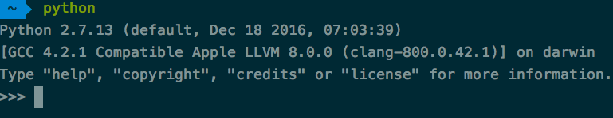
Installing & Running Python
Python comes pre-installed with Mac OS X and Linux
Windows http://python.org/
Anaconda https://docs.anaconda.com/anaconda/install/
virtual environment with conda: https://docs.conda.io/projects/conda/en/latest/user-guide/tasks/manage-environments.html
Options for an IDE http://stackoverflow.com/questions/81584
Interactive interface to Python
To exit Python:
exit() or CTRL-D
Running
python filename.py

Slide 6
Basic Data Types
# Numbers
a = 5
b = 3
print (a + b) * (a - b)
# Booleans
t = True
f = False
print t and f # Logical AND; prints "False“
print t != f # Logical XOR; prints "True“
# Strings
s = "hello" # use single quotes or double quotes
print s
print s.replace('l', '(ell)’)
# Type Conversion
print int(3.3)
print float(3)
Numbers
Integer and float
Booleans
Use words rather than symbols (&&, ||, etc.)
Strings
Type Conversion
int() - Converts compatible data into an integer.
float() - Converts compatible data into a float.
str() - Converts compatible data into a string

Slide 7
Operators
+, -, *, /, %, >, <
== : is equal to
!= : not equal to
> : greater than
< : less than
>= : greater than or equal to
<= : less than or equal to
and, or, not
print 2*2 # 4
print 2**3 # 8 print 10%3 # 1
# Difference between floating point # division and integer division (python2) print 1.0/2.0 # 0.5 print 1/2 # 0
print "Ni!"*3 # 'Ni!Ni!Ni!’
print "hello " + "world!"
print 2+2==5 or 1+1==2 # True print not(2+2==5) and 1+1==2 # True

Slide 8
Variables
Variables are names that can point to data.
The assignment operator (=) assigns data to variables.
Variable names can be made up of letters, numbers and underscores (_), and must start with a letter.
You MUST assign something to a variable (to create the variable name) before you try to use (evaluate) it.
Radius = 10
pi = 3.14159
area = pi * Radius * Radius
print area
# 314.15

Slide 9
Containers
# Lists
a = [5, 3, 4, 1, 2]
print a, len(a)
a.sort(reverse=True) # from largest to smallest
print a
# indexing and slicing
print a[0] # index from 0
print a[-1] # -1 means the last one
print a[0:2] # interval [0, 2), i.e., [a[0], a[1]]
a[1:3] = [-2, -3]
print a
# add / delete / extend
a.append(3)
del a[1]
a.extend([3,4,5])
print a
Lists
A list is resizable and can contain elements of different types

Slide 10
Containers
Tuples
Tuples are usually used in cases where a statement or a user-defined function can safely assume that the collection of values will not change.
zoo = ('python', 'elephant', 'penguin')
print 'Number of animals in the zoo is', len(zoo)
new_zoo = 'monkey', 'camel', zoo
print 'Number of cages in the new zoo is', len(new_zoo)
print 'All animals in new zoo are', new_zoo
print 'Animals brought from old zoo are', new_zoo[2]
print 'Last animal brought from old zoo is', new_zoo[2][2]
print 'Number of animals in the new zoo is’, len(new_zoo)-1+len(new_zoo[2])

Slide 11
Containers
Dictionaries
A dictionary stores (key, value) pairs
# Dictionaries
# create a new dict of <key, value> pairs
name_to_age = {'alice': 10, 'bob': 12, 'eve': 20}
print name_to_age
# modify and access a <key, value> pair
name_to_age['alice'] = 11
print name_to_age['alice']
# remove a <key, value> pair
del name_to_age['eve’]
# loops with key
for name in name_to_age:
print '{} : {}'.format(name, name_to_age[name])
# loops with key and value
for name, age in name_to_age.iteritems():
print '{} : {}'.format(name, age)

Slide 12
Control Flow
numberOfWheels = 3
# if statement
if (numberOfWheels < 4):
print “You don't have enough wheels!”
print “I'm giving you 4 wheels!”
numberOfWheels = 4
print “You now have”, numberOfWheels, “wheels”
# else
if ( numberOfWheels < 3):
print “You are a motorcycle!”
else:
print “You are a Car!”
print “You have”, numberOfWheels, “wheels”
# elif
if ( numberOfWheels == 1):
print “You are a Unicycle!”
elif (numberOfWheels == 2):
print “You are a Motorcycle!”
else:
print “That's a LOT of wheels!”
if statement
if / else
if / elif / else
if ( boolean expression ):
STATEMENT
STATEMENT
elif (2nd boolean expression ):
STATEMENT
STATEMENT
else:
STATEMENT
STATEMENT

Slide 13
Control Flow
number = 23
running = True
while running:
guess = int(input('Enter an integer : '))
if guess == number:
print 'Congratulations, you guessed it.'
# this causes the while loop to stop
running = False
elif guess < number:
print 'No, it is a little higher than that.'
else:
print 'No, it is a little lower than that.'
else:
print 'The while loop is over.'
# Do anything else you want to do here
print 'Done'
while statement
repeatedly execute a block of statements as long as a condition is true.

Slide 14
Control Flow
for loop
another looping statement which iterates over a sequence of objects
break statement
continue statement
for i in range(1, 5):
print i
for val in "string":
if val == "i":
break
print val
print "The end"
for val in "string":
if val == "i":
continue
print val
print "The end"

Slide 15
Functions
# Functions
def sign(x):
if x > 0:
return 'positive'
elif x < 0:
return 'negative'
else:
return 'zero'
for x in [-1, 0, 1]:
print sign(x)
def hello(name, loud=False):
if loud:
print 'HELLO, %s!' % name.upper()
else:
print 'Hello, %s' % name
hello('Bob’)
hello('Fred', loud=True)
Python functions are defined using the def keyword
return statement
Define functions to take optional keyword arguments

Slide 16
Functions
x = 50
def func():
global x
print 'x is', x
x = 2
print 'Changed global x to', x
func()
print 'Value of x is', x
local variables
global variables
lambda expressions
points = [{'x': 2, 'y': 3},
{'x': 4, 'y': 1}]
points.sort(key=lambda i: i['y'])
print points
# [{'y': 1, 'x': 4}, {'y': 3, 'x': 2}]

Slide 17
Modules
Collection of functions and variables, typically in scripts
Definitions can be imported
from..import statement
# exercise
# create module fibo.py
# def fib(n): # write Fib. series up to n
# import module
# import fibo
import numpy as np
import math
from math import cos, pi
from math import *
# Use modules:
# fibo.fib(1000)
math.pi
# can give it a local name:
# fib = fibo.fib
# fib(500)

Slide 18
Modules
Built-in dir() function returns list of names defined by an object.
If the object is a module, this list includes functions, classes and variables, defined inside that module.
import sys
# get names of attributes in sys module
dir(sys)
# get names of attributes for current module
dir()
# create a new variable 'a’
a = 5
dir()
# delete/remove a name
del a
dir()

Slide 19
Classes
class Greeter(object):
# Constructor
def __init__(self, name):
self.name = name # Create an instance variable
# Instance method
def greet(self, loud=False):
if loud:
print 'HELLO, %s!' % self.name.upper()
else:
print 'Hello, %s' % self.name
g = Greeter('Fred') # Construct an instance
g.greet() # print "Hello, Fred"
g.greet(loud=True) # print "HELLO, FRED!"
Classes Definition
Construct an instance
Call an instance method
Class ClassName:
<statement-1>
...
<statement-N>

Slide 20
Python Programming for Image Processing

Slide 21
Overview
Pillow
Pillow is a fork of PIL, the Python Imaging Library
Installation: https://pillow.readthedocs.io/en/latest/installation.html
Image Basics
http://pillow.readthedocs.org/en/latest/handbook/concepts.html
List of Modules
http://pillow.readthedocs.org/en/latest/reference/index.html
pip install Pillow

Slide 22
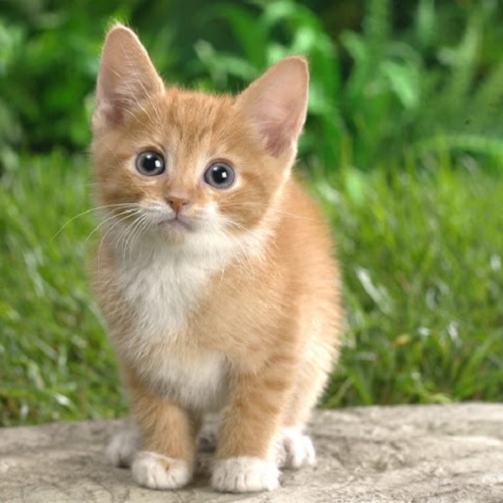
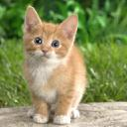
Image Reading / Writing
from PIL import Image
# read image
im = Image.open("cat.jpg")
print im.format, im.size, im.mode # JPEG (512, 512) RGB
im.show()
# create thumbnails
newsize = (128,128)
im.thumbnail(newsize)
# write image
outfile = "cat_ thumbnail.jpg"
im.save(outfile)
Input
Output

Slide 23
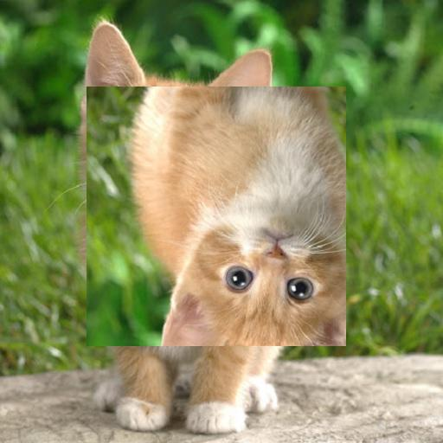
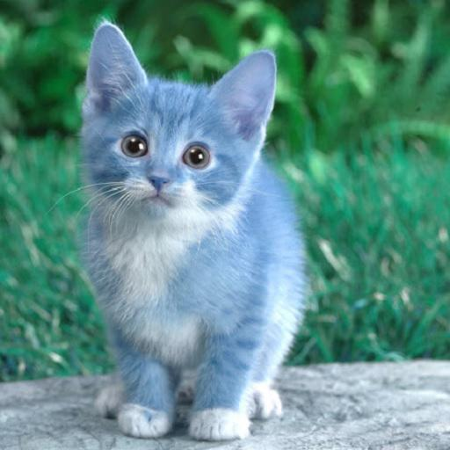
Image Cutting / Pasting / Merging
# Copying a subrectangle from an image
box = (100, 100, 400, 400)
region = im.crop(box)
# Processing a subrectangle, and pasting it back
region = region.transpose(Image.ROTATE_180)
im.paste(region, box)
# Splitting and merging bands
r, g, b = im.split()
im = Image.merge("RGB", (b, g, r))
Output 1
Output 2

Slide 24
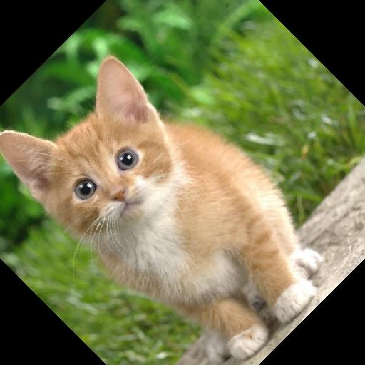
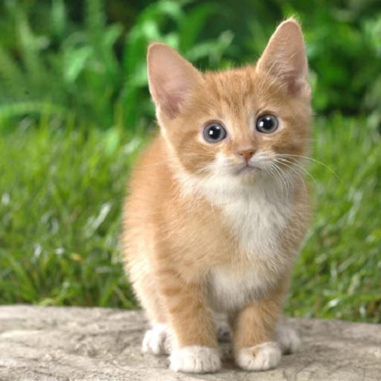
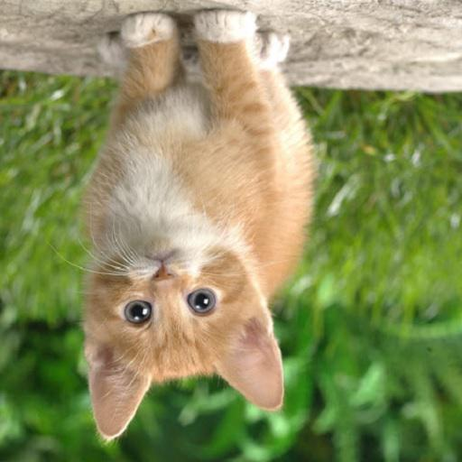
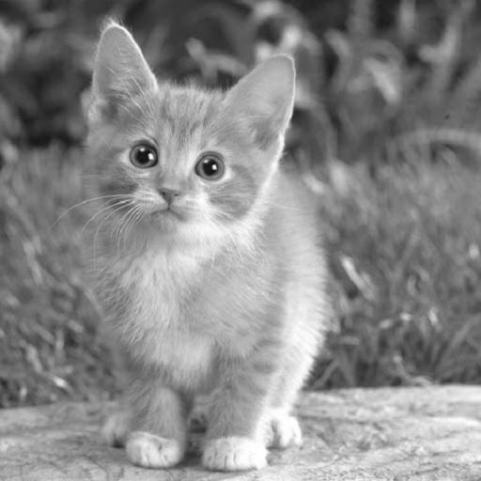
Geometric / Color Transformation
# geometric transforms:
out1 = im.resize((128, 128))
out2 = im.rotate(45) # degrees counter-clockwise
out3 = im.transpose(Image.FLIP_LEFT_RIGHT)
out4 = im.transpose(Image.FLIP_TOP_BOTTOM)
# color transforms:
out5 = im.convert("L")
Input
Output 1
Output 2
Output 3
Output 4
Output 5

Slide 25
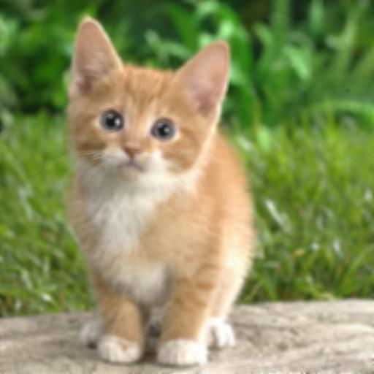
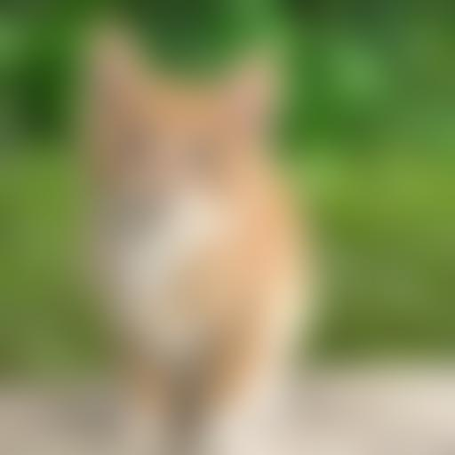

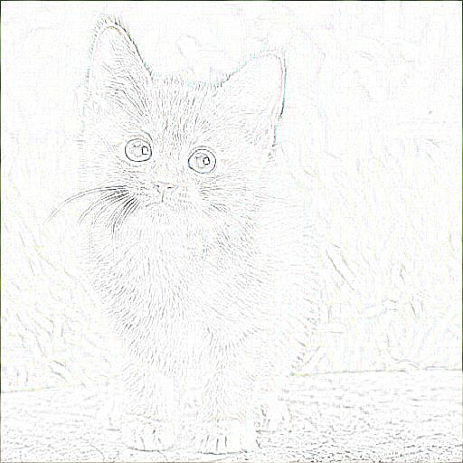
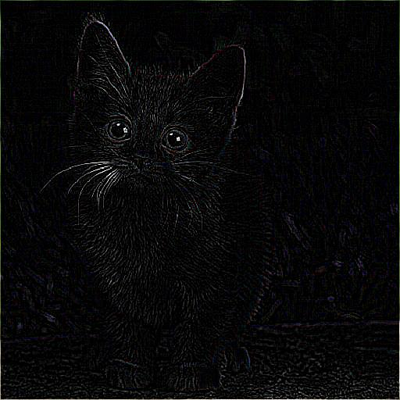
Image Filter
from PIL import ImageFilter
# image smoothing / sharping / edge
out1 = im.filter(ImageFilter.BLUR)
out2 = im.filter(ImageFilter.GaussianBlur(radius=20))
out3 = im.filter(ImageFilter.UnsharpMask)
out4 = im.filter(ImageFilter.CONTOUR)
out5 = im.filter(ImageFilter.FIND_EDGES)
Input
Output 1
Output 2
Output 3
Output 4
Output 5

